Slide 1
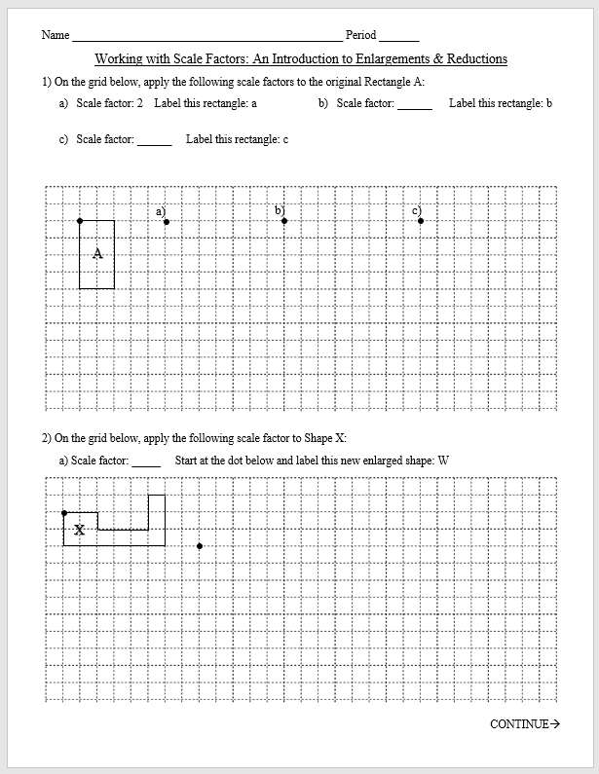
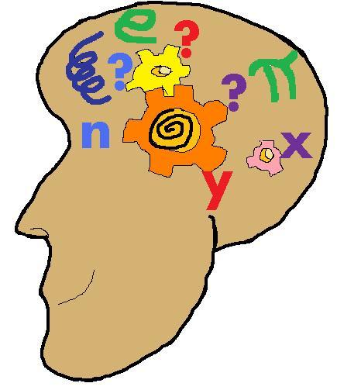
An Introduction to Scale Factors:
Enlarging Shapes & Letters

Slide 2
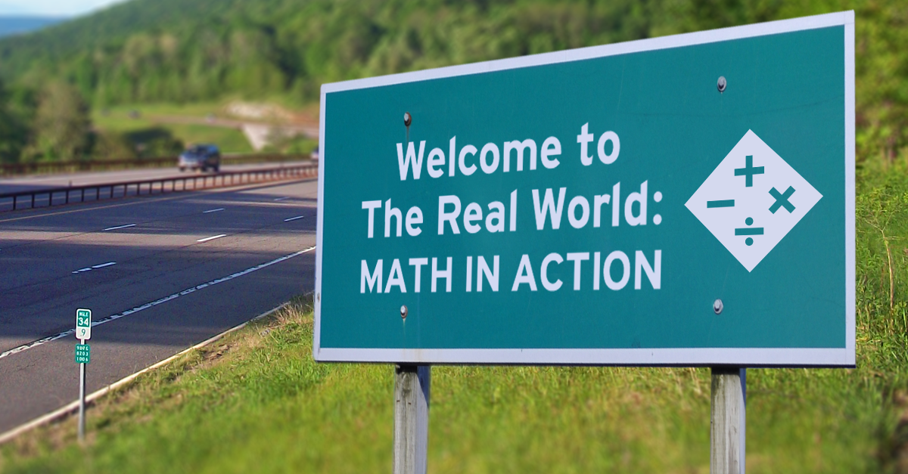
Today = SCALE FACTORS
Where do you think scale factors are used outside of school?

Slide 3
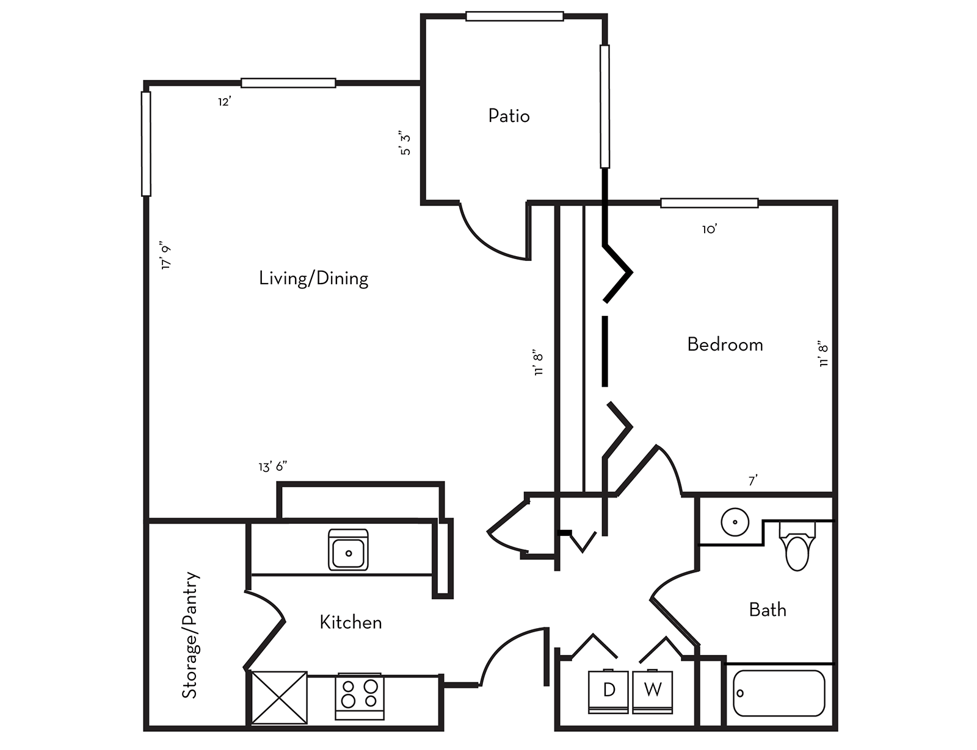
Scale Factors Are Used For:
Enlargements
Reductions
Blueprints
Floor Plans

Slide 4
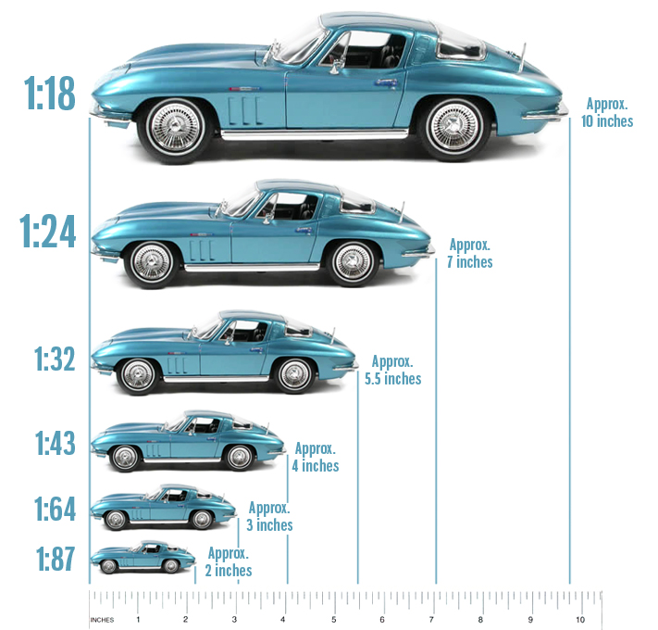
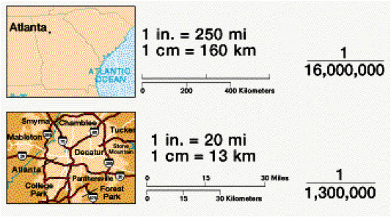
Scale Factors Are Used For:
Enlargements
Reductions
Blueprints
Floor Plans
Models
Maps

Slide 5
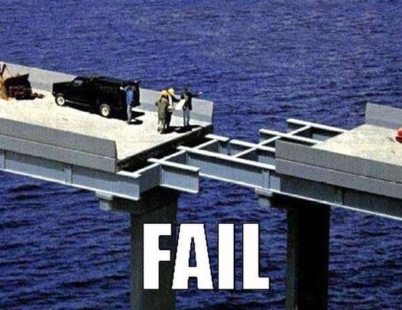
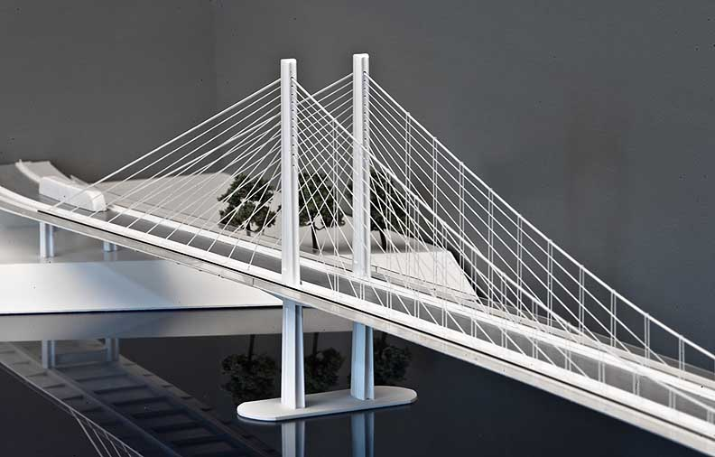
Model:

Slide 6
Incorrect Enlargement:
Original:
1 ft
1 ft
1 ft
2 ft

Slide 7
Incorrect Enlargement:
Original:
1 ft
2 ft
1 ft
1 ft

Slide 8
Enlargement:
Original:
2 ft
1 ft
1 ft
2 ft

Slide 9
Enlarge using a scale factor of 2.
4
M
EXAMPLE
8
N
6
12
You’ll be enlarging & reducing shapes.

Slide 10
Reduce using a scale factor of $\frac{1}{2}$.
EXAMPLE
2
L
4
M
3
6
You’ll be enlarging & reducing shapes.

Slide 11
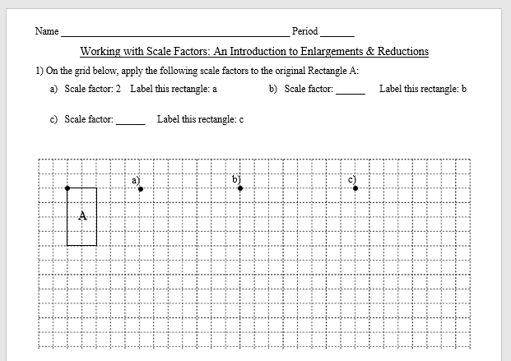
Your turn:

Slide 12
$$2×2$$
2
$$4$$
4
$$8$$
a
$$4×2$$

Slide 13
2.5
$$2×2.5$$
2
$$=5$$
4
$$=10$$
a
b
$$4×2.5$$

Slide 14
$$\frac{1}{2}$$
$$2∙\frac{1}{2}$$
$$=1$$
2
c
4
$$4∙\frac{1}{2}$$
a
$$=2$$
b

Slide 15
Based on the measurements of these triangles, what is the scale factor?
Original:
5
Think About It
3
4
15
$$3×5=$$
20
$$4×5=$$

Slide 16
Based on the measurements of these triangles, what is the scale factor?
$$\frac{1}{3}$$
Original:
4
4
12
12
4
12
Think About It
A scale factor is always a multiple.

Slide 17
$$3$$
$$1$$
$$3$$
$$2$$
$$2$$
$$3$$
$$3$$
$$2$$
$$6$$
$$6$$
$$6$$
$$3$$
$$9$$
$$9$$
$$6$$
W
$$18$$

Slide 18
$$\frac{1}{2}$$
$$10$$
$$5$$
g
G
$$3$$
$$4$$
$$6$$
$$8$$
$$2$$
$$4$$
$$2$$

Slide 19
$$2$$
$$2$$
$$2$$
$$2$$
$$2$$
$$10$$
$$2$$
$$2$$
$$10$$
$$2$$
$$6$$
$$6$$
$$2$$
$$2$$

